Slide 1
Bulldog Buckets: Quality Assurance
Hareem Bokhari, Cuishan Chen, Menghong Chen, Romer Chia, Katie Solokhina, FuYuan Yan

Slide 2
What tasks did your team set out to accomplish this semester?
We hoped to be able to conduct tests on the final project as we envisioned from the beginning (ready to publish).
We hoped to be able to study programming languages needed in the project and be able to check and test the codes other teams create.

Slide 3
What were some tools or techniques that helped make planning or collaboration easier? What didn’t?
Slack group chat helped us collaborate on what was done and what needs to be done, as well as served as a platform for our group to brainstorm and communicate ideas with each other.
Google slides helped us work on the presentation together.
Github allowed us to submit our work and instantly have everyone see it, edit it if needed, as well as allowed us to review the code and submit feedback to the contributor.

Slide 4
Accomplishments
Created test cases for all of the planned pages that we received from product team
Tested the pages that frontend uploaded to github
Gave opinions and feedbacks about the layout of the project
Studied basic codes of languages needed
We split into groups to focus on specific tasks.
We communicated well as a team.

Slide 5
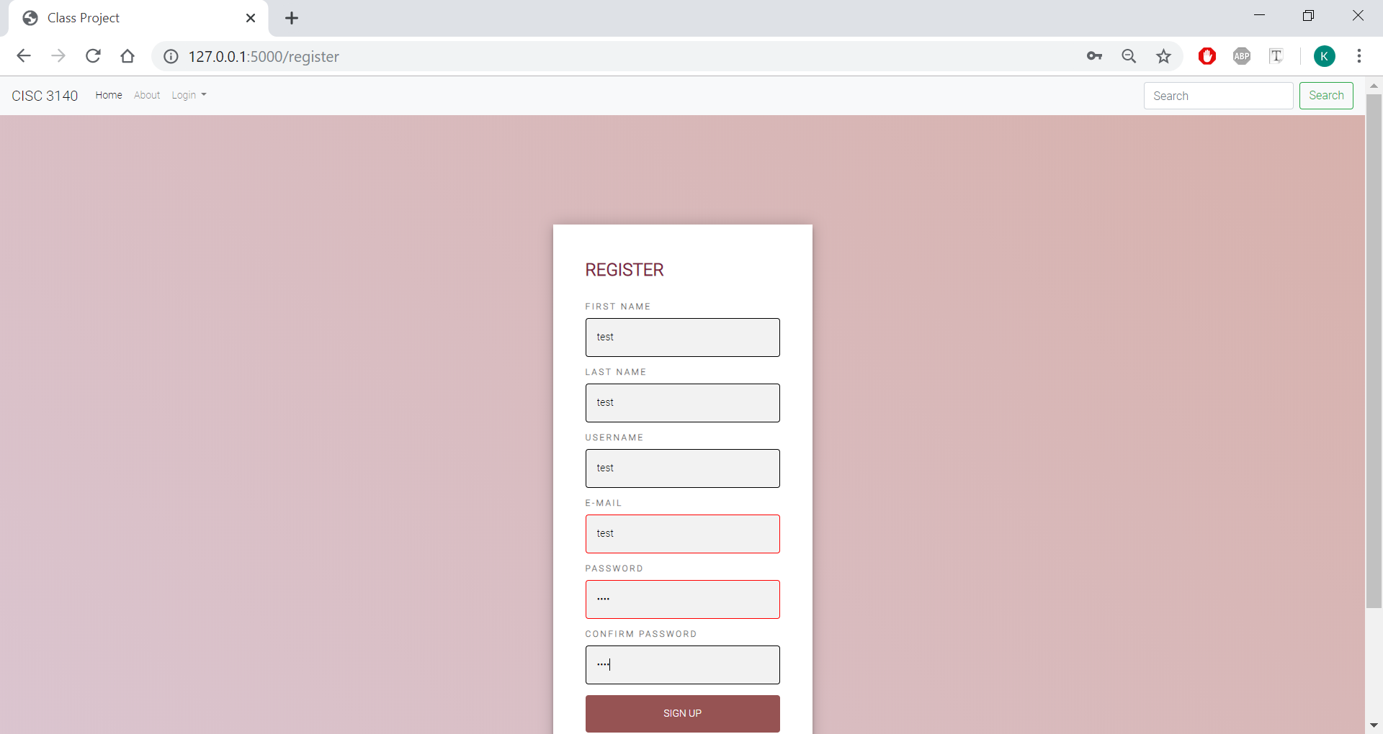
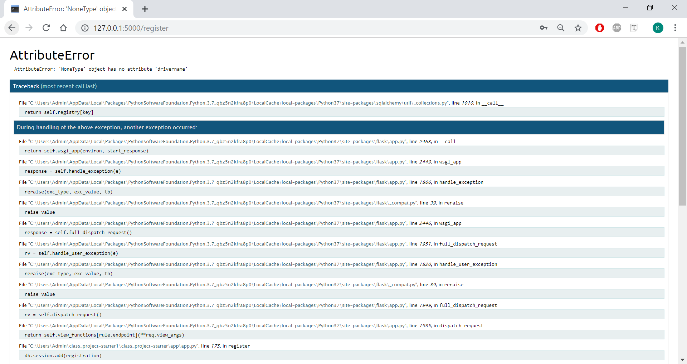
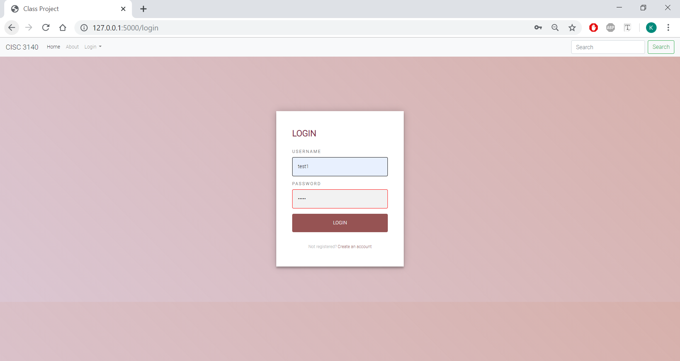
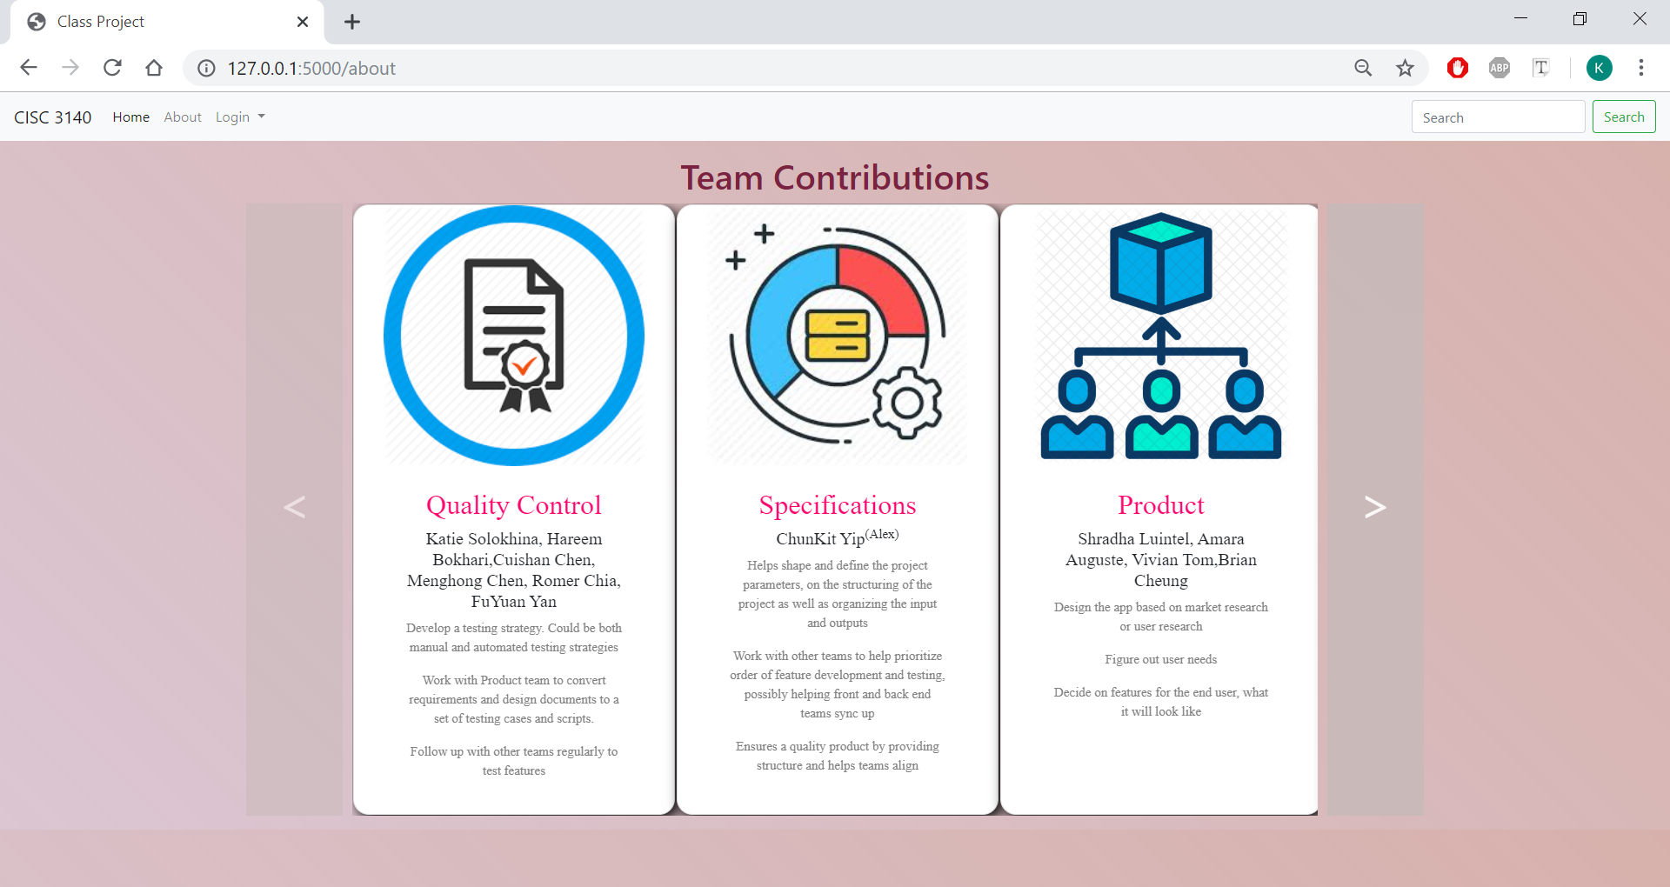
Test Cases

Slide 6
What is left unfinished? What hasn’t started yet?
We weren’t able to test the backend or the final project since none of us had the database set up on our computers.
We were not able to test the inside portion of the project. (Database is needed to do so)
We weren’t able to test the final project for create the user account to connect the home page and reset the password for each user account.

Slide 7
How was workload divided up, did it shift throughout the semester?
We first planned that each member study the languages that will be using in the project by ourselves, before we have things to test.
Later, we divided into 3 groups of 2 people each because there were a lot of different languages used. We all were supposed to focus on one code type -- so somebody for html/css/javascript, somebody for python and somebody for MYSQL.
Towards the end of the semester we did not receive the appropriate pages as per the project requirements, and so we all just focused on the pages given.

Slide 8
What challenges or obstacles did your team face?
One of the biggest challenges we faced was that we had to wait for other teams to do their part so that we could do something too.
Another one of the biggest challenges we faced was that we couldn’t access the website because the database wasn’t set up on our computers, so we couldn’t even test the final product that backend worked on.
We also experienced difficulties when reading and writing code because we didn’t have any experience with python, and so we spent time and effort learning the basics of python before we could contribute our own code.

Slide 9
Challenges (cont.)
Communication with other teams was also another challenge. Not everyone is familiar with slack, not everyone checks it daily, and not everyone is in the group chat. This made the communication with other teams harder. The only way was to find and talk to them while we have classes. However, there wasn’t too many chances to do so.

Slide 10
How to do better in the future?
Within the small team:
Not relying too much on other teams. When there is no instructions or products from other teams, we should do some other things that does not depends on other teams.
Communicate not only within the team, but also have a representative to communicate with other teams to see how their progress is and how can our team help them.
As the whole project team:
It will be helpful if all members agree on a way to communicate(email, phone, group chat).
Creating a approximate schedule for some important task. This way all members will have a sense about the time to do the project.
If possible, it will also be great if small teams can help each other out.

Slide 11
Conclusion
This group project is kind of stimulating what we will be facing when we work on companies. It is a great design to let us know and be familiar to the mode of working outside of the college. Although, for now, we haven’t completed the project because we don’t have full time working on it, we still gain a lot of experience while working on the project. With this experience, we have a deeper understanding in how to work as a team in a project. The most valuable thing we learned: communication is important.

